Slide 1
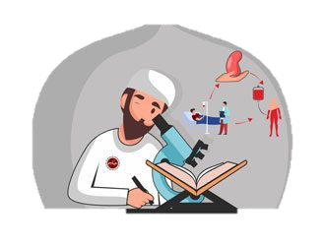
Where Bioscience, Islam, and Education Intersect:
Piloting a Novel Curriculum for Pre-Medical Muslim Students
Raudah M.Yunus
Postdoctoral Researcher
Medical College of Wisconsin

Slide 2







Multidisciplinary International Collaboration

Slide 3
Panel Presentation Overview
Curricular Goals & Frameworks
Seminar topics & contents
Evaluation findings
Practical application
Background Context

Slide 4
Existing Challenges
Secular social environment in western countries
Education systems that adopt secular frameworks derived from naturalistic epistemology
Lack of exposure to Islamic epistemology, even in Islamic schools
Negative impact:
Knowledge & spiritual crises when encountering ‘tensions’ between science and Islamic teachings
Low confidence & self-esteem
Unstable professional & religious identity

Slide 5
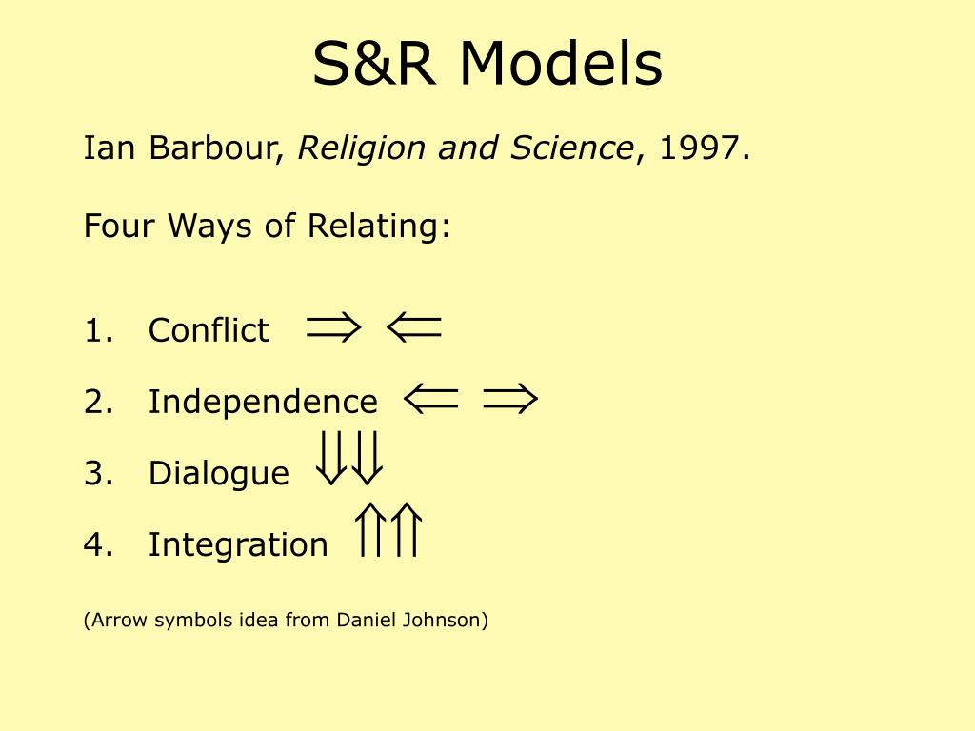

Curricular Goals
Develop students’ capacities to reason through perceived conflicts between religious and bioscientific claims.
Enhance students’ interest in, and preparedness and intention for, further engagement at the junction of Islam and bioscience.
Promote attitudinal change away from perceived inherent conflict between Islam and science.

Slide 6
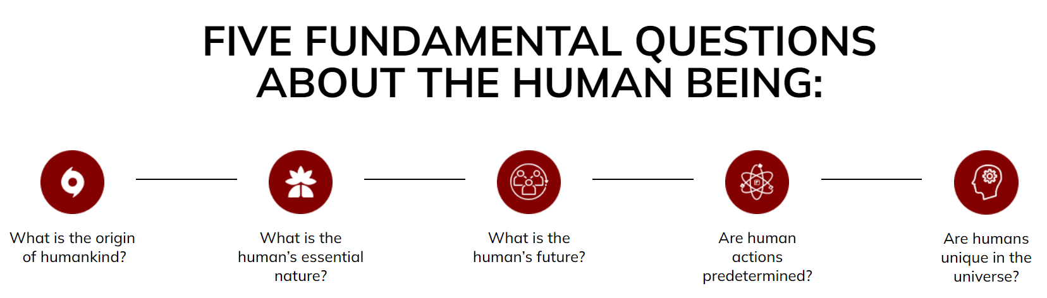
Curricular Features

Slide 7
Curricular Features
5 Big Questions
Co-taught by bioscientist & theologian dyad with dual training
Emphasis on critical inquiry & plurality, not absolute truth-finding
‘Islamic’ epistemology as the foundation
Curriculum polished and simplified by pedagogical experts
Multimodal
Instruction

Slide 8

Seven Seminars
What Do We Know and How Do We Know It? Reasoning Exercises in Islam and Science
How did Human Beings Come About? Evolution and God's Special Creation.
What does it mean to be a Human Being? Neuroscience, Artificial Intelligence and the Soul
Human Enhancement and Transhumanism: Are we changing, and should we change our being?
Are We Programmed or Do We Have Free Will? Discussions on Fate and Genetic Determinism
Are Human Beings Unique in this Universe? Science and Theological Inquiry about Extraterrestrial Life.
Knowledge Café and Harvest

Slide 9
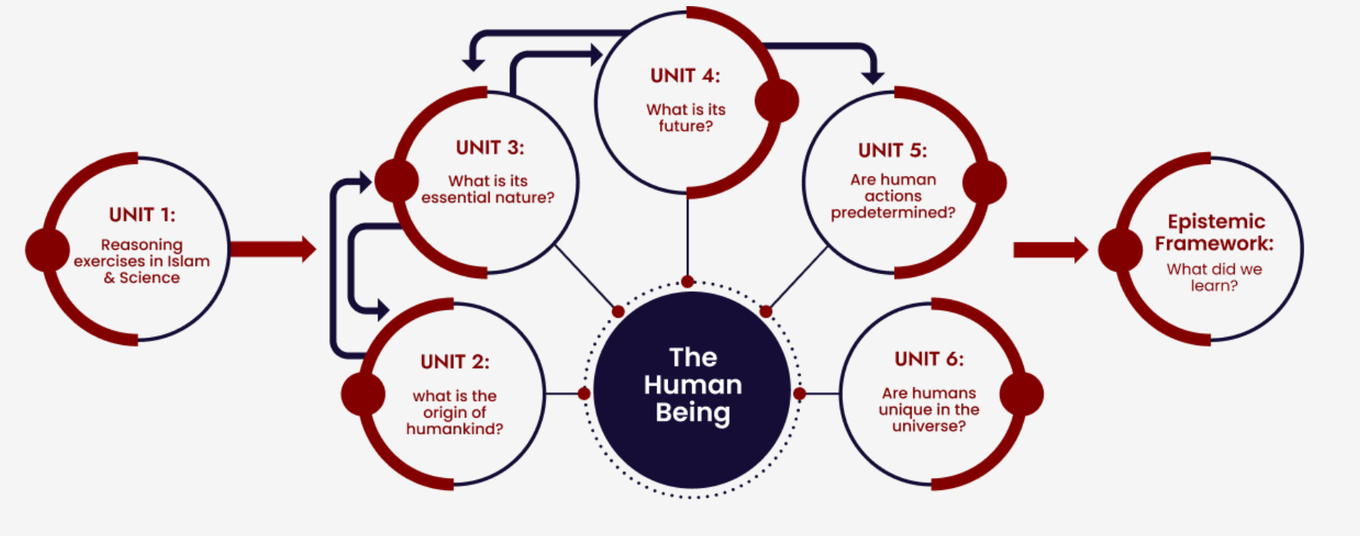
Topical relationships

Slide 10
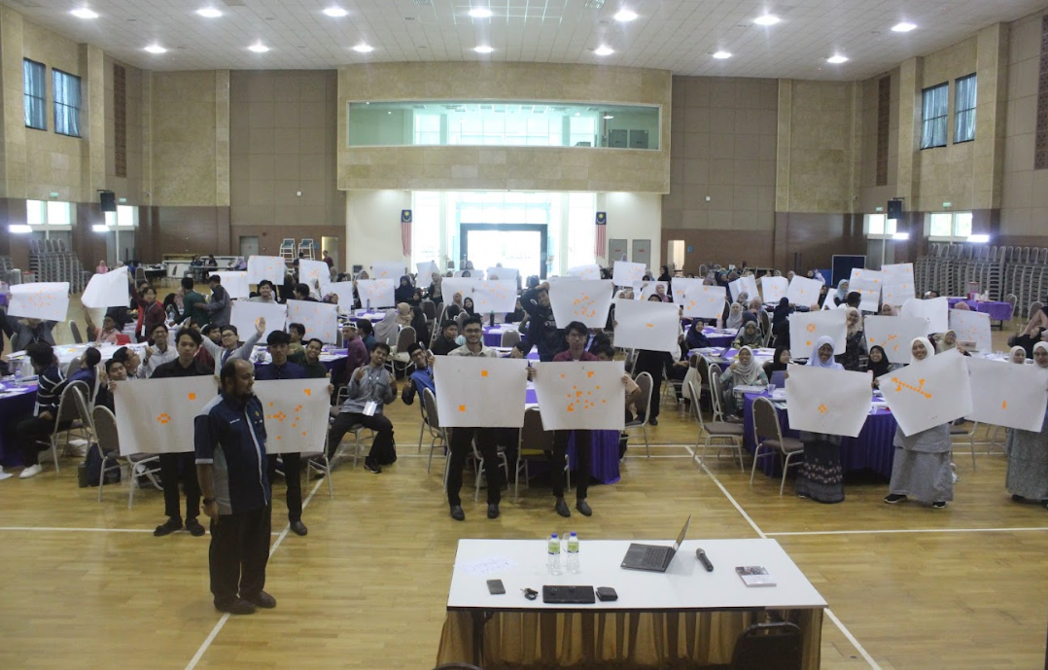

Slide 11
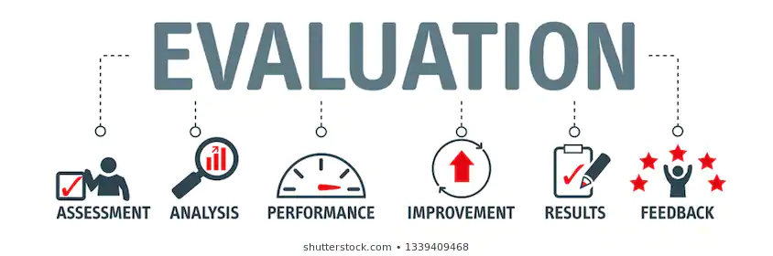

OUR FINDINGS

Slide 12
Our Theory of Change
Input
Developed Subject Matter Expertise
Activities
Curriculum development
Output
Students exposed to knowledge and skills at this intersection
Outcome
Impact
Institutional support & collaborations
Financial & Human Resources
Seminar delivery (in 2 countries)
Program evaluation
Seminar content transformed into teaching modules
Data on program efficacy
FOR BOTH STUDENTS & FUTURE INSTRUCTORS
Improved knowledge
Enhanced interest, preparedness & intention
Change of view/belief
Rationale
&
Underlying assumptions
Long-term goals:
Improve reasoning capacity & critical thinking
Solidify Muslim professional identities
Change discourses around Islam and Science

Slide 13
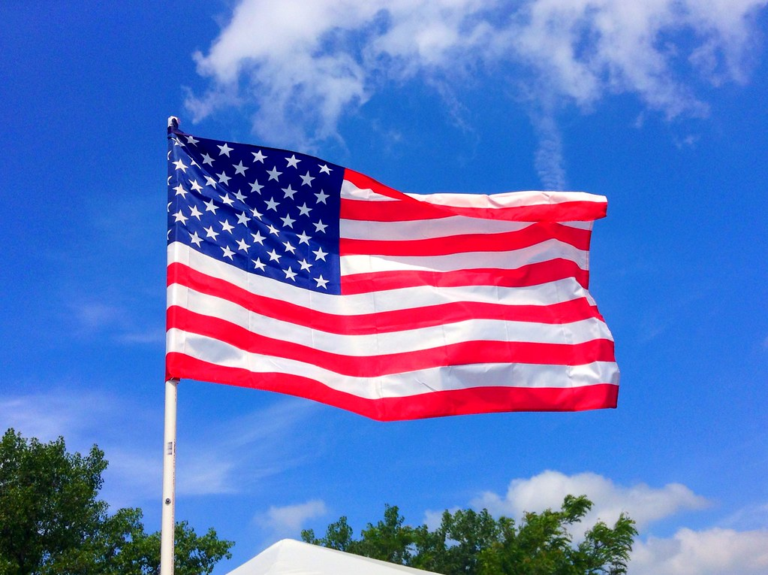

Program Participants
50 high school students
190 pre-university students
5 private Islamic schools in Chicagoland & Milwaukee
Aged 16-18
Centre for Foundation Studies, IIUM Pahang
Aged 18-19

Slide 14
Cohort differences
Geographical setting
Muslim minority vs Muslim majority context
Socio-demographics – ethnicity & age
Educational level – high school vs. pre-university (foundation center)
Islamic education – private Islamic high school vs. Islamic higher learning institution (but students from diverse high schools)
Challenges
Muslim identity formation in a largely secular environment
Navigating the influx & growing western/secular influences within a non-secular environment (Islamic + multifaith country)

Slide 15
Data Collection & Analytical Approach
Quantitative (Survey) = pre & post
Qualitative (Reflective essays)
Integration of data

Slide 16
Sociodemographic Backgrounds
Variable | All N (%) or Mean (SD) | By Cohort
 |  | Malaysia | USA
Age | 18.5 (0.08) | 19.0 (0.02) | 16.4 (0.11)
Sex Male Female | 65 (31.3) 143 (68.7) | 48 (28.6) 120 (71.4) | 17 (42.5) 23 (57.5)
Ethnicity Malay South Asian Arab African American Others | 165 (69.3) 26 (12.5) 10 (4.8) 2 (1.0) 5 (2.4) | 165 (98.2) 3 (1.8) | 26 (65.0) 10 (25.0) 2 (5.0) 2 (5.0)
Cohort/Country Malaysia USA | 168 (80.8) 40 (19.2) | NA | NA
Religiosity (DUREL-5) ORA NORA IR | 4.40 (0.09) 4.31 (0.09) 13.1 (0.12) | 4.33 (0.10) 4.38 (0.11) 13.15 (0.14) | 4.73 (0.21) 4.00 (0.21) 13.13 (0.23)

Slide 17
Outcome variables
Knowledge
Interest
Intention
Preparedness
Belief/View
SURVEY

Slide 18
Our hypotheses
The seminars will:
Increase students’ knowledge
Boost students’ interest
Enhance students’ sense of preparedness
Increase students’ intention
Change the attitude/belief toward R-S relationship
…to inform others, learn, engage with, and purse advanced courses & opportunities for research and career at this intersection

Slide 19
Knowledge
30 questions – 5 Qs from each seminar
True/False & Multiple Choice – 1 point if correct, 0 otherwise
Belief
10 statements that assess students’ view on the compatibility of bioscience & religion (Islam)
Higher score = more compatible
Intention
Preparedness
Interest
11 statements in specific topics
4 statements that assess readiness to learn more, engage in, and pursue further opportunities at this intersection.
6 statements that gauge students’ desire to take action to pursue advanced learning and further opportunities at this intersection.
3 statements on keenness to learn more & pursue opportunities at this intersection
VARIABLES

Slide 20
Essays
Students were given the choice to write essays or create infographics
Essays covered learning experiences
  How the program affected views or understandings of science-religion relationships
68 essays
Salient themes:
- new knowledge gained – factual & conceptual
- skills and values
- religious connection
- career motivation
-views on the relationship between science & Islam

Slide 21

Change in Knowledge
Overall increase from 12.1 at baseline to 18.1 post-seminar (p<0.01)
Malaysian cohort: 11.5 to 18.0 (p<0.01)
American cohort: 14.7 to 18.6 (p<0.05)

Slide 22
Quotes from essays:
“..this seminar (series) has greatly influenced and improved my overall understanding and knowledge about the questions I have constantly had in mind but was always scared to ask” (Participant 2, Chicago)
“I got so much new knowledge about Islam and bioscience. The speakers were able to solve the riddle in my mind as they explained to us about the relation between Islam and bioscience” (Participant 7, IIUM)
“This seminar (series) taught me so much about my connection with God and how science and God can be brought together” (Participant 24, Chicago)
“I also found it astonishing how I could easily answer most of the post-seminar questions confidently compared to the moment I did with the pre-ones” (Participant 35, IIUM)

Slide 23
Types of knowledge
Factual
Essential terminologies, basic information
Documented social phenomena, Qur’anic verses
Conceptual
Classification of knowledge sources, propositions/truth claims
Differences between Islamic & naturalistic epistemology, evidence analysis

Slide 24
Quotes from essays:
Factual knowledge:
“Extraterrestrial intelligent life is defined as hypothetical extraterrestrial life that is capable of thinking, and [doing] purposeful activity” (Participant 2, female, Malaysia).
“CRISPR stands for Clustered Regularly Interspaced Short Palindromic Repeats and is a simple yet powerful tool for editing genomes” (Participant 12,male, USA).
“The term fitra isused in the Quran and refers to the intrinsic essence or disposition that Allah has given to each and every person” (Participant 27, male, Malaysia)

Slide 25
Quotes from essays:
Conceptual knowledge:
“It opened my mind to see the significantdifference between the Islamic epistemology and naturalistic epistemology…Islamic epistemology accepts rational judgment, empirical judgment and revelatory judgement, [this is]different from naturalistic epistemology which only uses empirical judgment.” (Participant 46, male, Malaysia)
“Based on Muslim theologians, humans have four sources of knowledge which are [the]intellect, the five senses, true reports based on the testimony and intuition (Ilhām). These sources of knowledge then [are] supported by judgements which consist of revelatory, rational, and empirical.” (Participant 44, male, Malaysia)

Slide 26

Change in Interest
Overall increase from 11.4 at baseline to 11.8 post-seminar (p<0.05)
Malaysian cohort: 11.4 to 12.1 (p<0.05)
American cohort: 11.4 to 10.8 (not statistically significant)

Slide 27
Change in Preparedness
Overall increase from 10.4 at baseline to 13.4 post-seminar (p<0.05)
Malaysian cohort: 10.4 to 13.6 (p<0.05)
American cohort: 10.8 to 12.8 (p<0.05)

Slide 28
Change in Intention
Overall increase from 19.6 at baseline to 20.9 post-seminar (p<0.05)
Malaysian cohort: 19.8 to 21.5 (p<0.05)
American cohort: 18.7 to 18.5 (not statistically significant)

Slide 29
Quotes from essays:
“After completing the seminar series, my perspective on science and Islam changed…they have made me more interested in further pursuing a career in science” (Participant 12, Chicago)
“..the seminar (series) has had a profound impact… It has sparked passion in me to examine how science and faith interact” (Participant 101, IIUM)
“I aim to apply the insights gained from this seminar to bridge the gap between science and religious communities” (Participant 3, IIUM)
“This seminar has instilled in me a strong determination to pursue and immerse myself further in the fields of theology and science” (Participant 5, IIUM)
“It (seminar series) increased my confidence and has made me more excited to study about both (domains) and their relationships” (Participant 11, Chicago)

Slide 30

Change in Beliefs (Views) on Religion & Science
Overall decline from 16.3 at baseline to 15.6 post-seminar (p<0.05)
Malaysian cohort: 16.1 to 15.4 (p<0.05)
American cohort: 17.1 to 16.6 (not statistically significant)

Slide 31
Quotes from essays:
3 types of relations
Harmony
&
compatibility
Conflictual
Tensions exist, but harmony is possible

Slide 32
Bioscience & Islam are in harmony
“There is frequently a belief that science and religion cannot coexist and that one develops at the expense of the other. This is a false statement, it fails to capture the rich and complex nature of the interaction between science and religion. This seminar gave a clearer understanding of how science and religion can coexist and complement one another” (Participant 8, Chicago)
“The most noticeable difference I can see is a shift in my thought process when it comes to Islam and science, from stating that Islam and science are incompatible to asserting that both are compatible” (Participant 11, IIUM)
“…the conference really helped me realize that Islam and science are more closely
related than I originally thought” (Participant 13, IIUM)

Slide 33
Bioscience & Islam are conflictual
“Formerly, I thought everything about science and Islam was consistent with each other. It turns out that there are conflicts and contradictions. The difference is just the way we resolve them” (Participants 25, IIUM)
“This session taught me about various scientific concepts that are at odds with Islamic viewpoints (Participants 47, IIUM)
“There are many conflicts (raised) during this seminar and also ways to resolve them and how our thinking process should be” (Participant 59, IIUM).

Slide 34
Tensions exist, but harmony is possible
“Conflicts may arise when attempting to reconcile Islam and bioscience, but from my perspective, such conflicts are acceptable. Resolving conflicts between bioscience and Islam requires a thoughtful and balanced approach…there can be a harmonious relationship between bioscience and Islam. (Participant 61, IIUM)
“Islam and science have different points of view… I also learnt that Islam and science are totally compatible with each other” (Participant 9, IIUM)
“I think that this seminar helped me to see science and Islam in a different perspective…I will try my best to link Islam and science in a harmonious manner” (Participant 99, IIUM)

Slide 35
Additional incentives of the seminars:
Acquisition of skills: Critical thinking & communication
Acquisition of values: Altruism, growth, integrity, self-assurance, religious connection

Slide 36
Essay Quotes:
Skills & Values
“It (the seminar) teaches me how to critically evaluate evidence and how to resolve conflicts between Islam and science.” (Participant 31, male, Malaysia)
“They challenged us to utilize what we have learned…and find solutions by thinking outside of the box. This allows us to improve our communication skills and enhance our problem-solving ability.” (Participant 45, male, Malaysia)
“I began to appreciate the importance of ethical considerations in scientific research.” (Participant 48,female, Malaysia).

Slide 37
Essay Quotes:
Skills & Values
“This discussion challenged my own beliefs about free will in religion and science. A main theme that emerged from the seminar was the importance of approachingcomplex issues with an open and curious mindset.” (Participant 9, male, USA)
“This seminar allowed me to ask questions that otherwise may have stumped me later on in life and weakened my imān (faith)” (Participant 10, female, USA)

Slide 38
Our reflections:
Additional incentives – beyond original learning outcomes
Student perception of Islam & science relationship becomes more nuanced and critical
The epistemological framework helps in systematic thinking & problem-solving
Notions of conflict: A result of seminar make-up & choice of emphasis
Connection to career motivation & Islamic values → stable professional identity
Notes:
1. Intentionality matters -- when teaching bioethics or areas to cross-over theology and science, one needs clarity on what is being taught and why. Our team spent months clarifying and creating detailed lesson plans, selecting topics, and most importantly establishing an epistemology based framework that we found most effective to convey knowledge about theology, science and their intersection.
2. We did not seek to always provide students clear-cut answers, but rather a framework of epistemology from which students could assess evidence from all realms of knowledge while appreciating the standards of evidence may differ or be prioritized differently (e.g. empirical evidence for science, revelational evidence for wahy)
3. Teachers must spend time to appreciate the world-view in which their students live. We observed some clear differences in the nature of questions and approach between Muslim students living and raised in Chicago compared to students raised in Malaysia. Would add discussion points based on the actual data we acquired, but my very subjective observation was the Malaysian students found it easier to dismiss scientific discoveries/challenges in favor of revelation and held a more 'Islam-centric' worldview while US students were searching for a way to navigate between them and had a more 'Pragmatic' world view.
4. Certainty and uncertainty were very useful concepts that played well for both discussions of empirical evidence and revelation evidence.
5. Students are more adaptable than teachers may assume and are willing to engage in abstract discussions even when teachers may be more uncomfortable

Slide 39
Curricular Application
Curricular contents have been translated to teaching modules
Teaching modules are now freely available & downloadable in the project website
July 2024: Online teacher training with US Islamic school teachers
January 2025: Online teacher training with Australian Islamic school teachers
February 2025: In-person training with medical school educators in Malaysia
May 2025: In-person teacher training at ISNA Edu Forum

Slide 40
Curricular Application & Sustainability
Dissemination & Uptake
Targeted audience
(Educators vs. Students)
Tailored activities & training
(in-collaboration with host institution)
Geographical location
(USA & Anglophone vs. Muslim countries)
Field of study
(bioscience/health-allied vs Islamic studies)

Slide 41
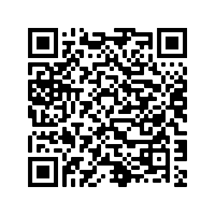
VISIT OUR PROJECT & CURRICULUM

Slide 42


