Slide 1
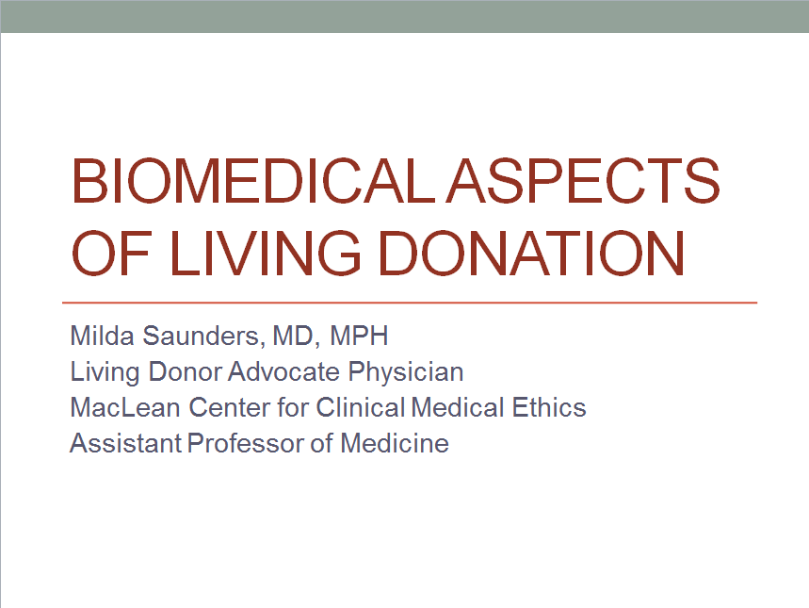

Slide 2
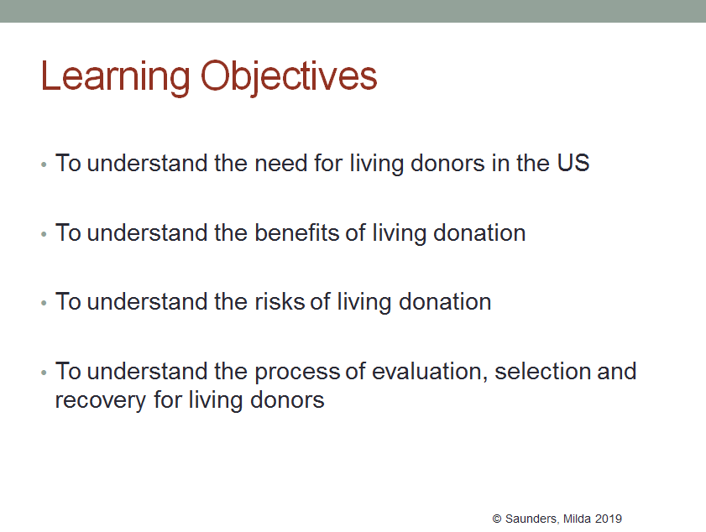

Slide 3
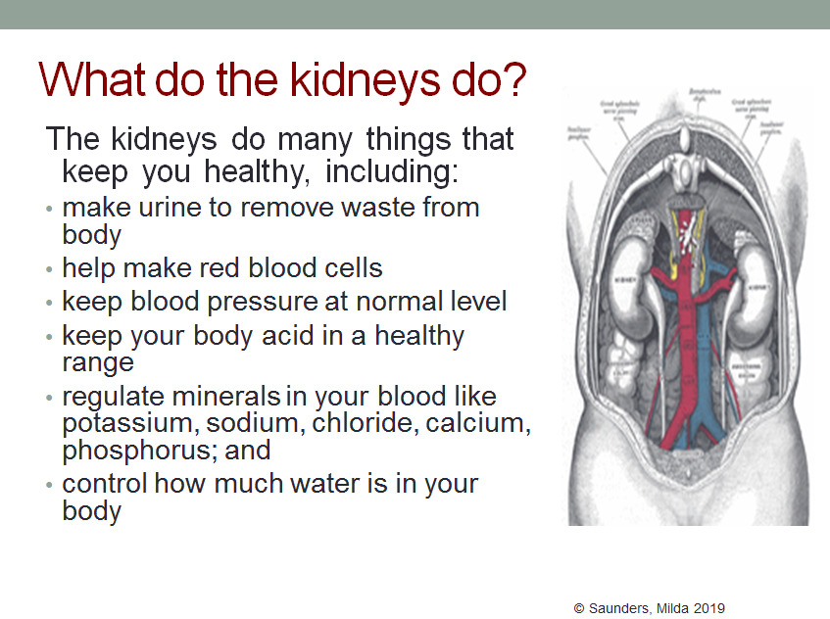

Slide 4
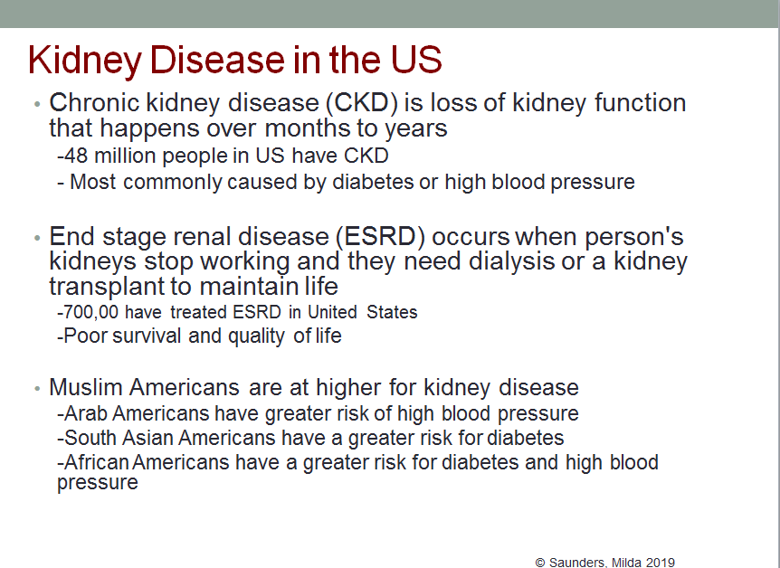
Notes:
Race: the U.S. government has classified people as white if they have “origins in any of the original peoples of Europe, the Middle East or North Africa. This may soon change. In recent years, advocacy groups for Arab Americans and others have argued that being classified as white does not reflect the self identity of Americans from the Middle East or North Africa.¹¹ In response, the U.S. Census Bureau is considering a new “MENA” category for people from the Middle East and North Africa for possible use in the 2020 census and census surveys.¹²
End Stage Renal Disease represents a major and growing public health problem. This graph shows the number of existing and newly treated patients with ESRD from 1984 projected through the year 2010. Approximately 370,000 people have End Stage Renal Disease in the United States, and the number of prevalent cases is projected to top 600,000 people in the year 2010. The cost to society of treating patients with ESRD is significant. We spend approximately $50,000 per year per patient for dialysis and medication expenses, and this cost is covered primarily by Medicare.

Slide 5
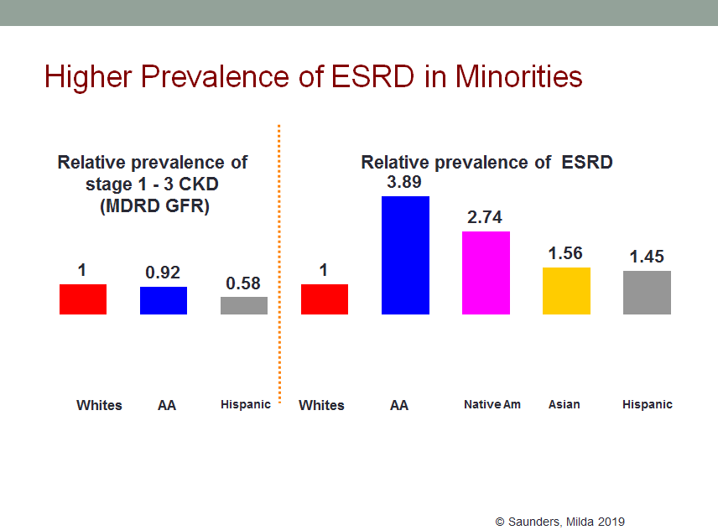
Notes:
Coresh J, et al. Am J Kidney Dis. 2003 Jan;41(1):1-12;
USRDS 2002 Annual Data Report
Hsu CY, et al. J Am Soc Nephrol 14 : 2902-2907, 2003

Slide 6
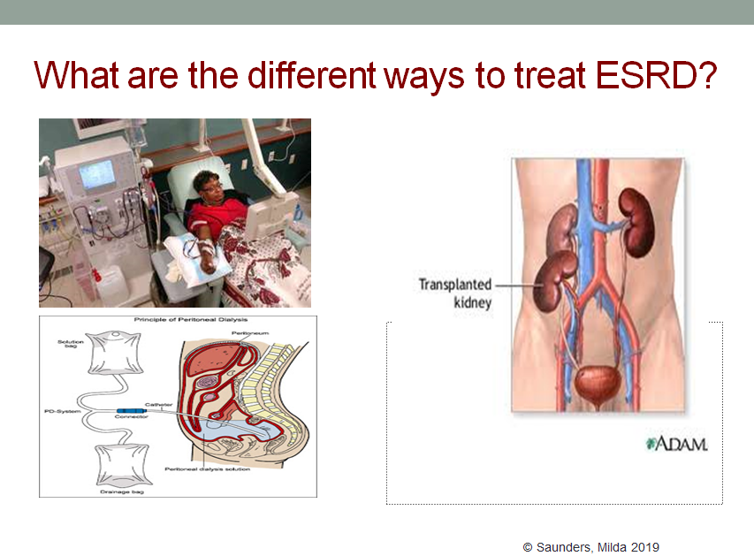
Notes:
All pts with ESRD: 30% transplant; 70% dialysis (93% HD, 7%PD)

Slide 7
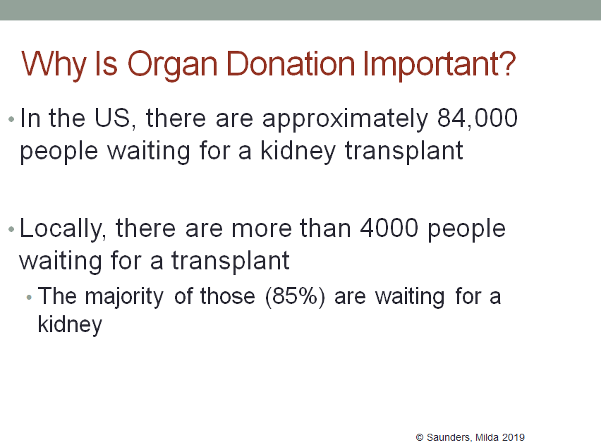

Slide 8
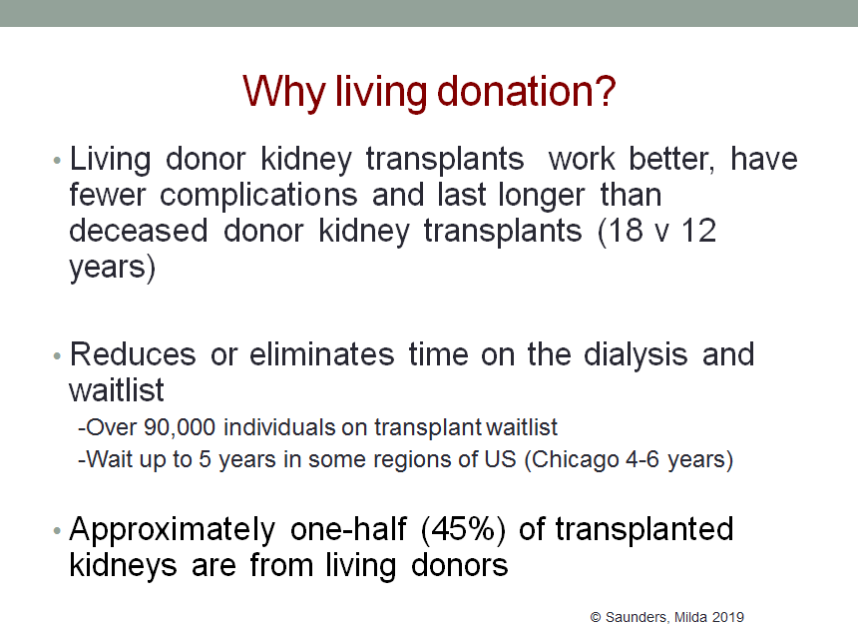
Notes:
Approx 140,000 total

Slide 9
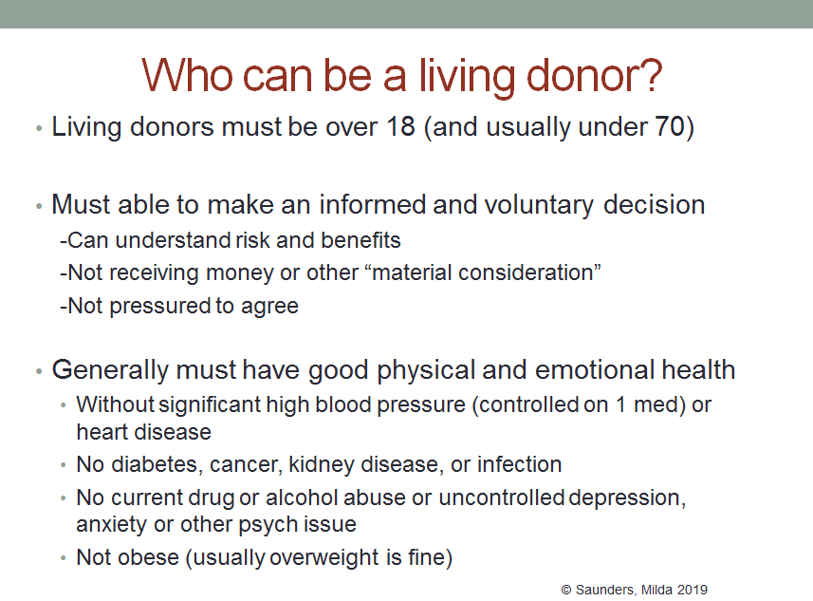

Slide 10
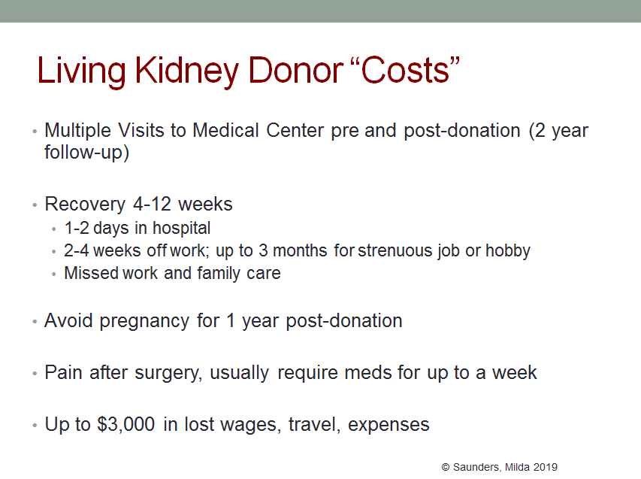

Slide 11
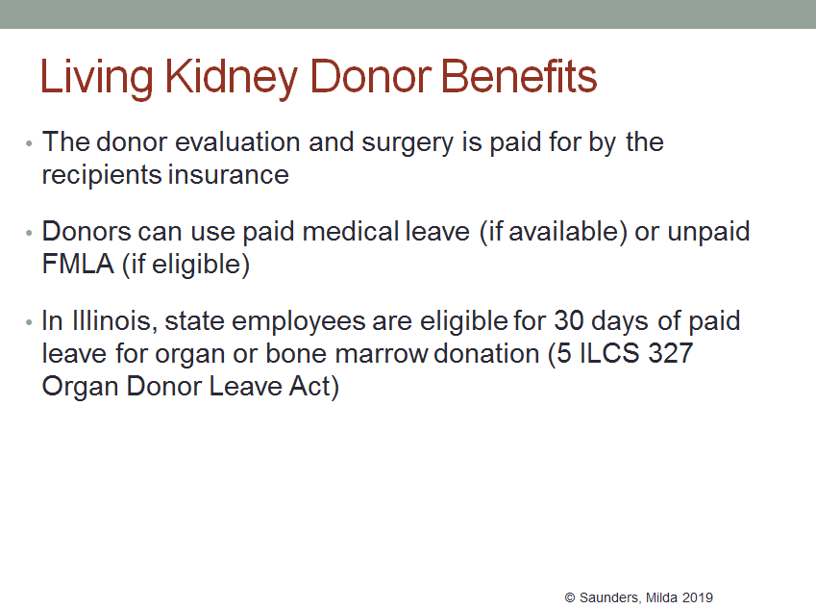
Notes:
https://www.kidney.org/sites/default/files/LDTaxDed_Leave.pdf

Slide 12
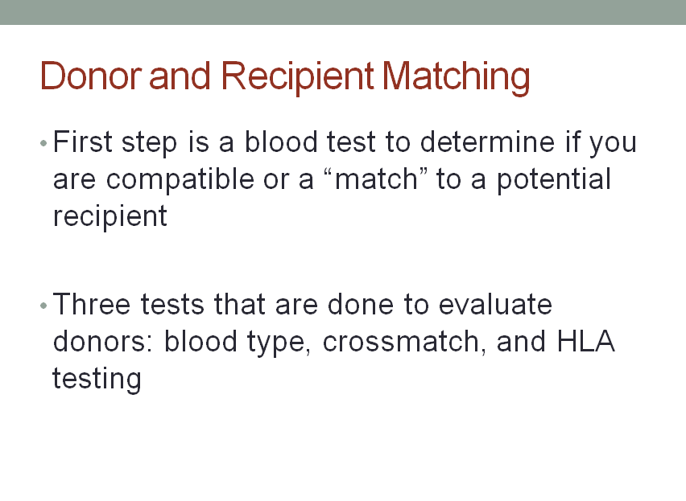
Notes:
REALLY the first step is even considering donation. If you are considering donation, the first step is to contact a transplant center (either the one of your intended recipient with kidney disease if a directed donation or in general for a non-directed.

Slide 13
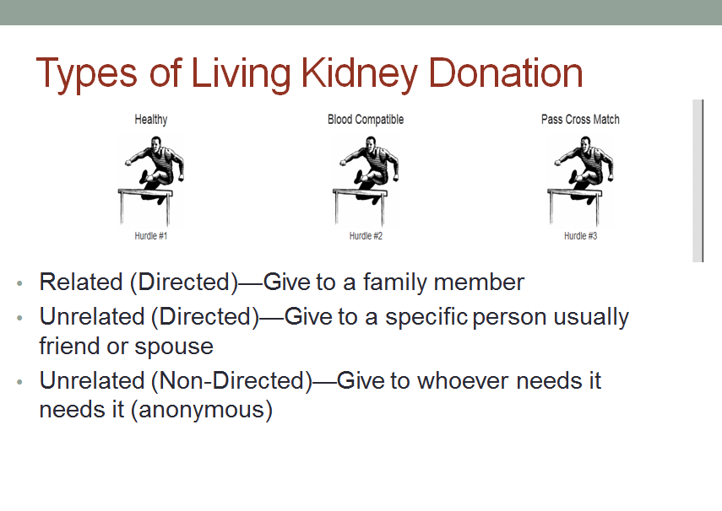

Slide 14
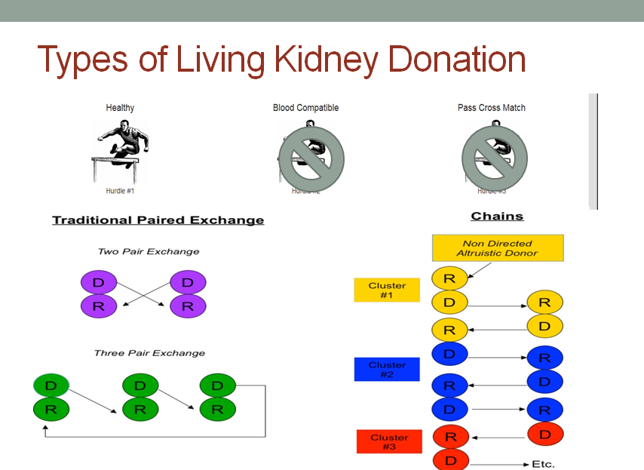

Slide 15
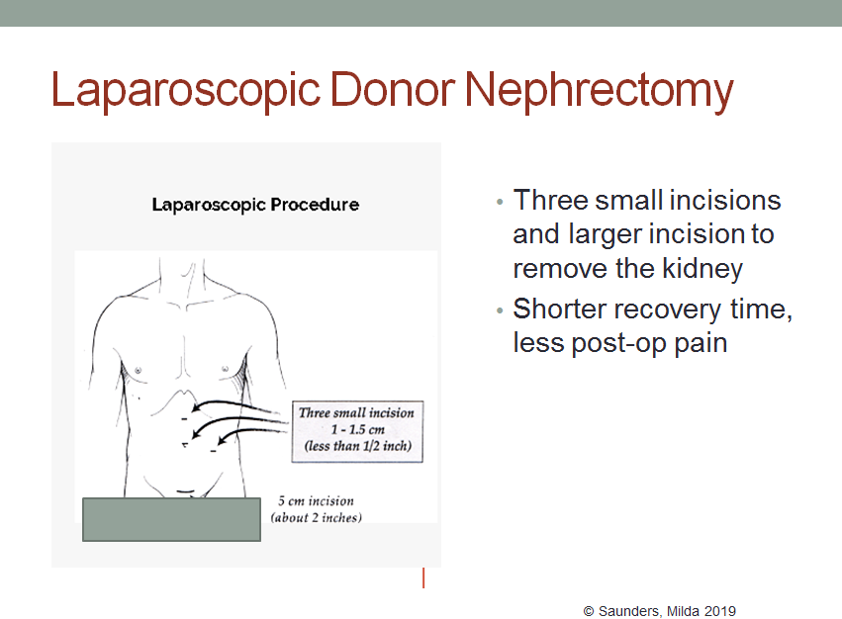
Notes:
A kidney is now usually removed using “keyhole” or laparoscopic surgical techniques. It involves a number of small incisions (1–3 cm each), through which instruments are inserted to remove the kidney. A larger incision is then made to take the kidney out. Keyhole surgery may take longer to perform than open nephrectomy, but the recovery time is quicker because the incisions are smaller.

Slide 16
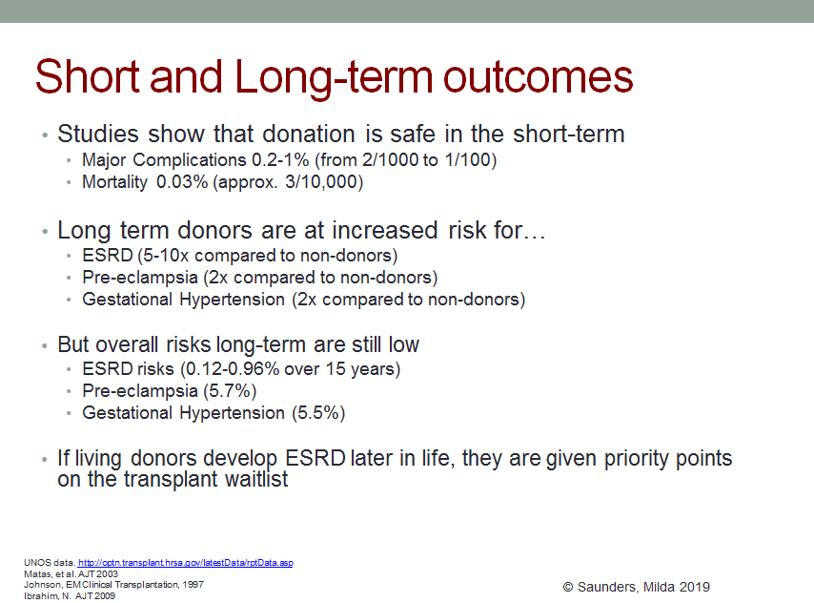
Notes:
First performed in 1954
Major Complication 0.2-1%
Mortality 0.03%
At donation in 2008, 19.5% were obese, 2.0% had a history of hypertension, and 3.5% had proteinuria. The median estimated GFR of living donors was 92.2 ml/min. Additionally, 12.2% of donors were reported not to have health insurance at the time of donation. By racial background, 14.9% of black and 17.0% of Hispanic donors did not have insurance at donation. Perioperative complications included blood transfusion (0.4%), reoperation (0.5%), and vascular complications (0.2%). Death occurred within 30 days of donation in 0.03% donating between October 1999 and December 2008. During those same years, overall donor death was 2.8%.

Slide 17
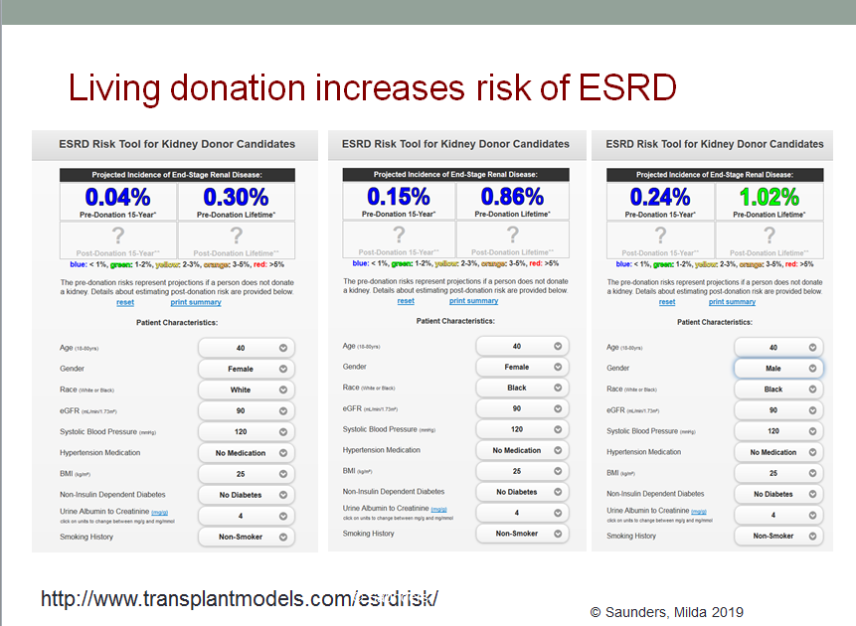
Notes:
White Male 0.06%
Pre-Donation 15-Year* 0.43%

Slide 18
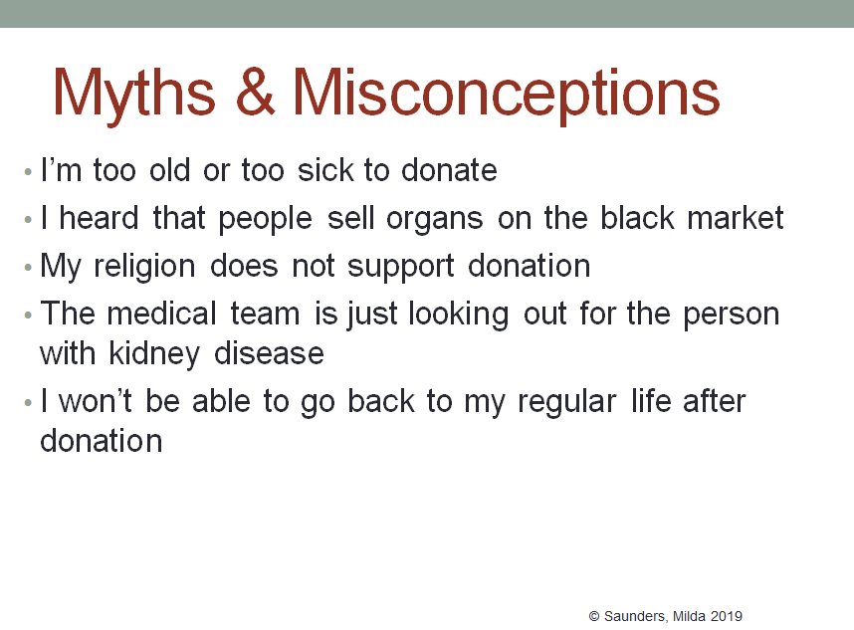

Slide 19
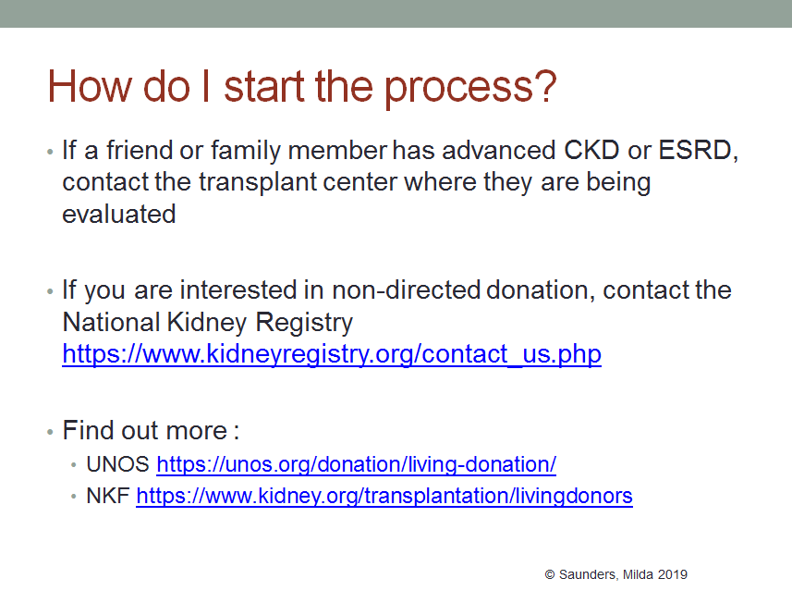
Notes:
National Kidney Registry: https://kidneyregistry.org/?cookie=1
UNOS: https://unos.org/transplant/living-donation/
NKF:https://www.kidney.org/transplantation

Slide 20
