Slide 1
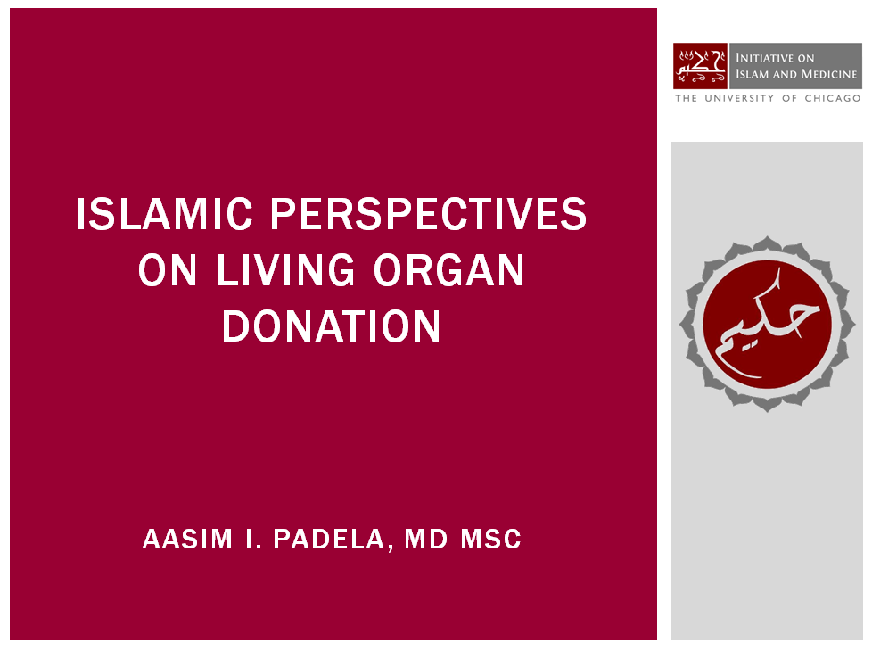

Slide 2
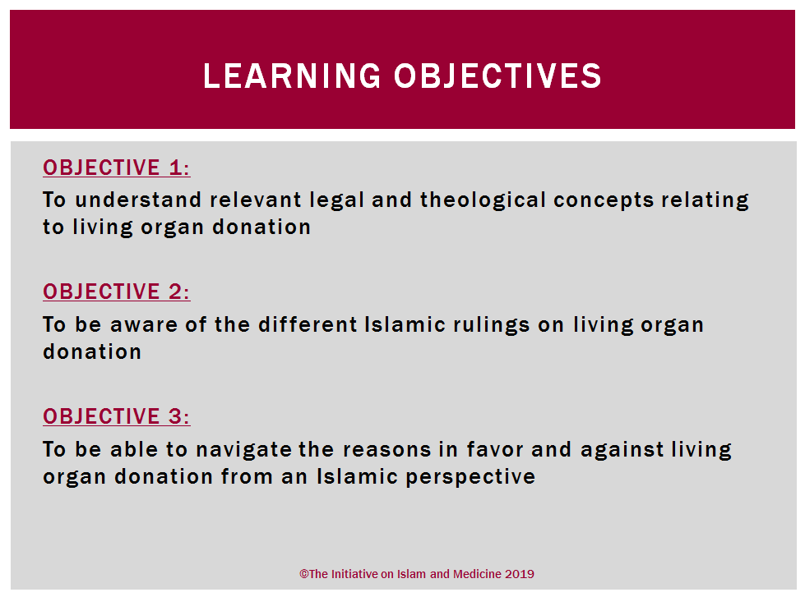

Slide 3
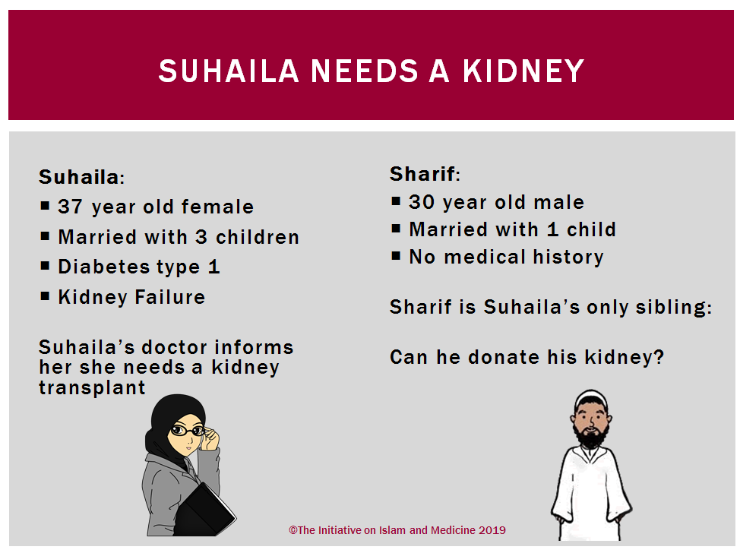

Slide 4
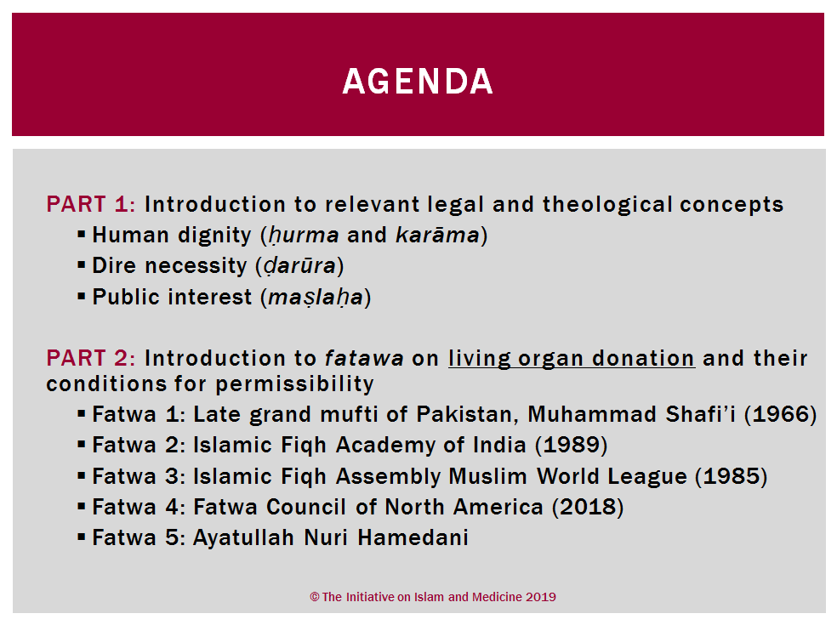

Slide 5
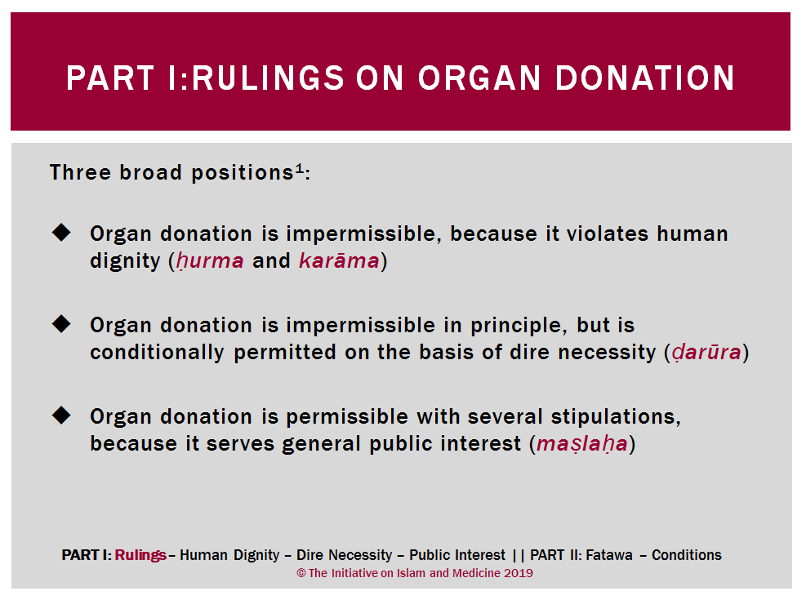

Slide 6
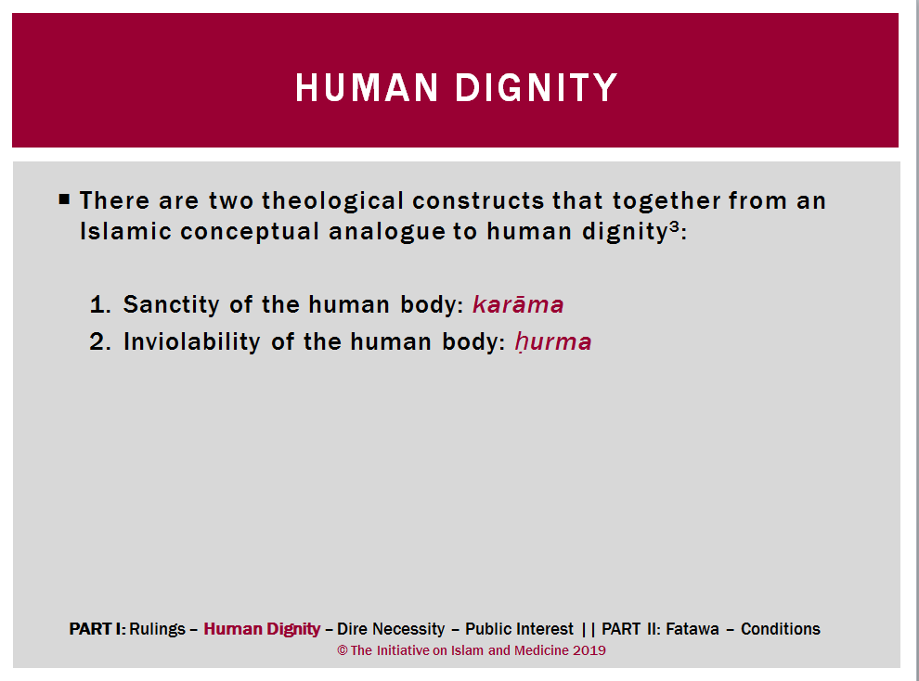

Slide 7
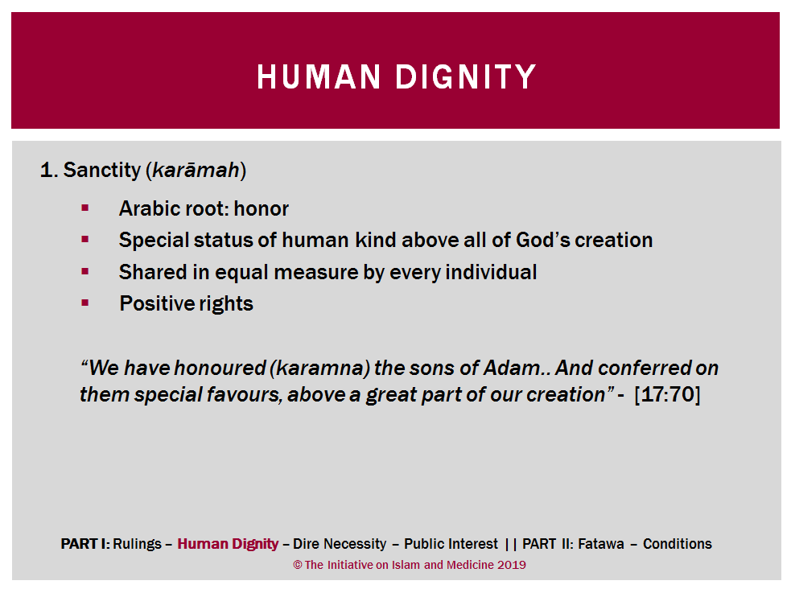

Slide 8
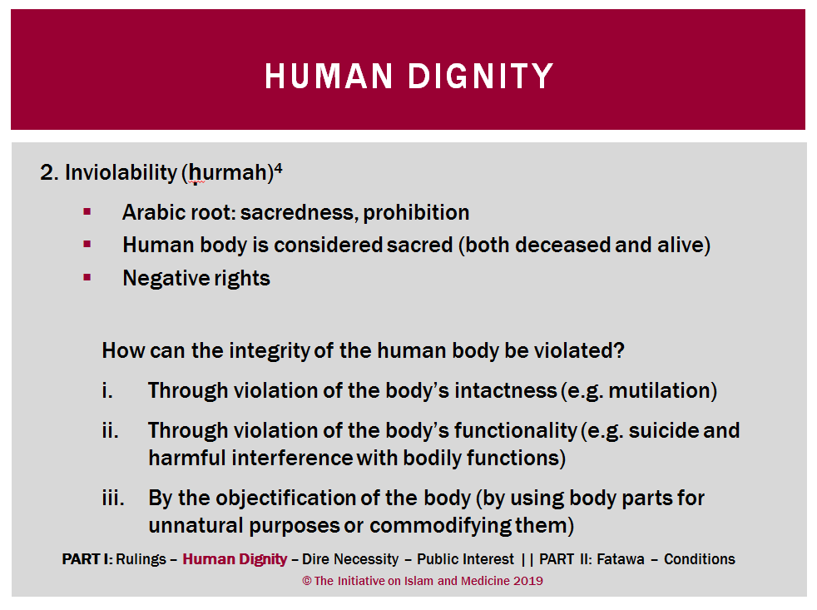

Slide 9
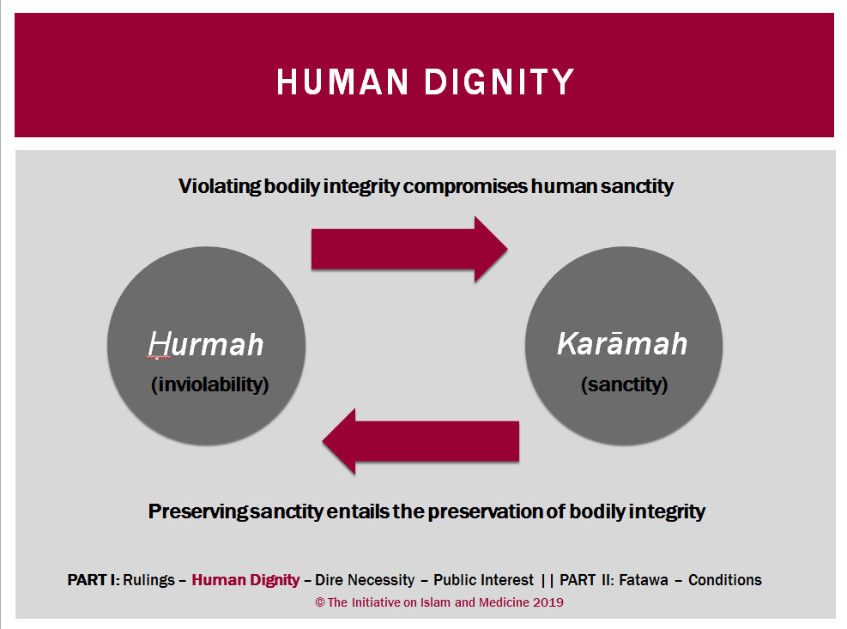
Notes:
Breaking bones hadith: https://sunnah.com/search/?q=breaking+bones

Slide 10
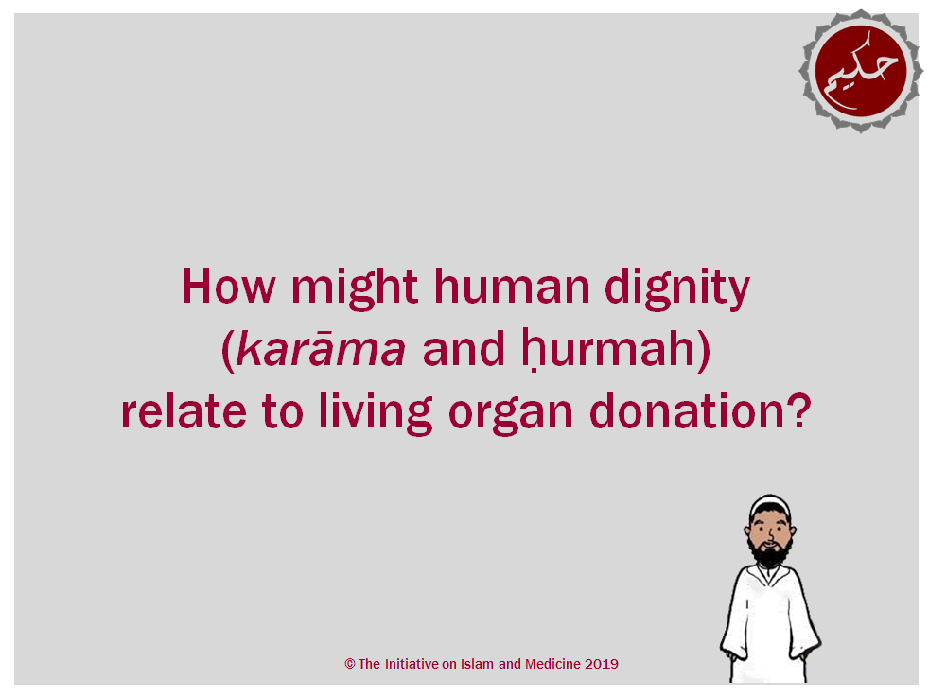
Notes:
Note: Use this slide as an opportunity to pause and engage audience in discussion.

Slide 11
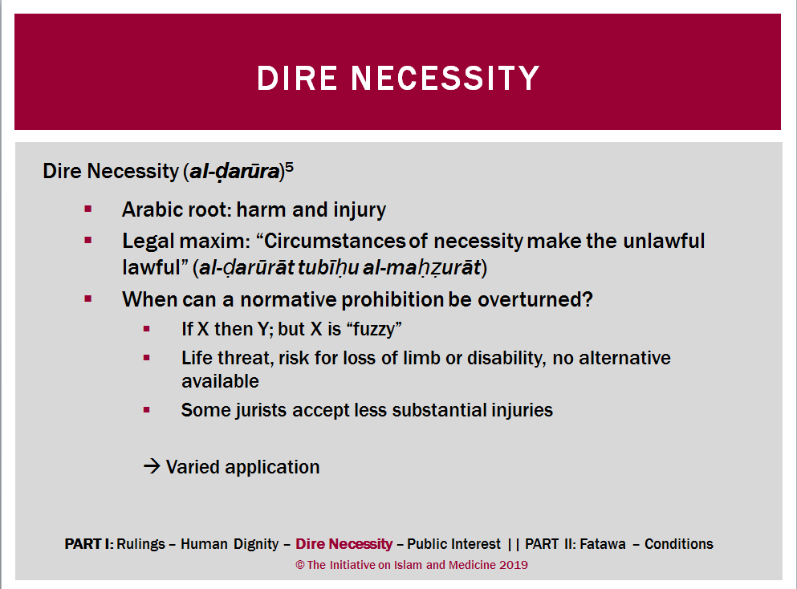
Notes:
Source:
Padela (2013) Dire necessity and transformation/ entry-points for modern science in Islamic bioethical assessment of porcine products in vaccines
Ebrahim - The islamic juridical principle of necessity and its application in the field of biomedical interventions

Slide 12
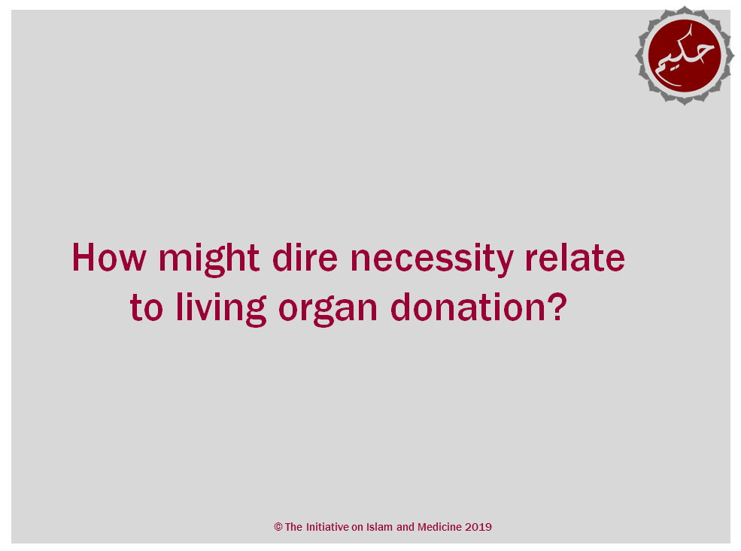
Notes:
Note: Use this slide as an opportunity to pause and engage audience in discussion.

Slide 13
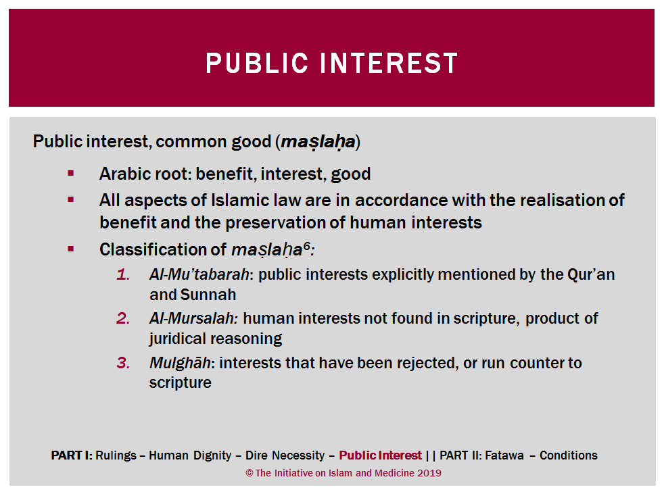

Slide 14
Notes:
Note: Use this slide as an opportunity to pause and engage audience in discussion.

Slide 15
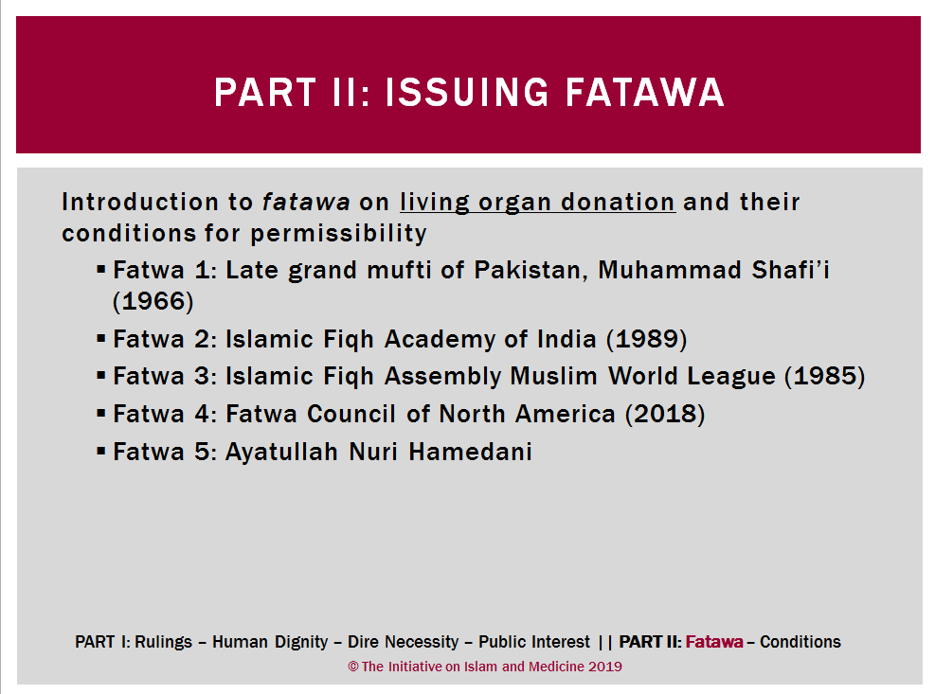

Slide 16
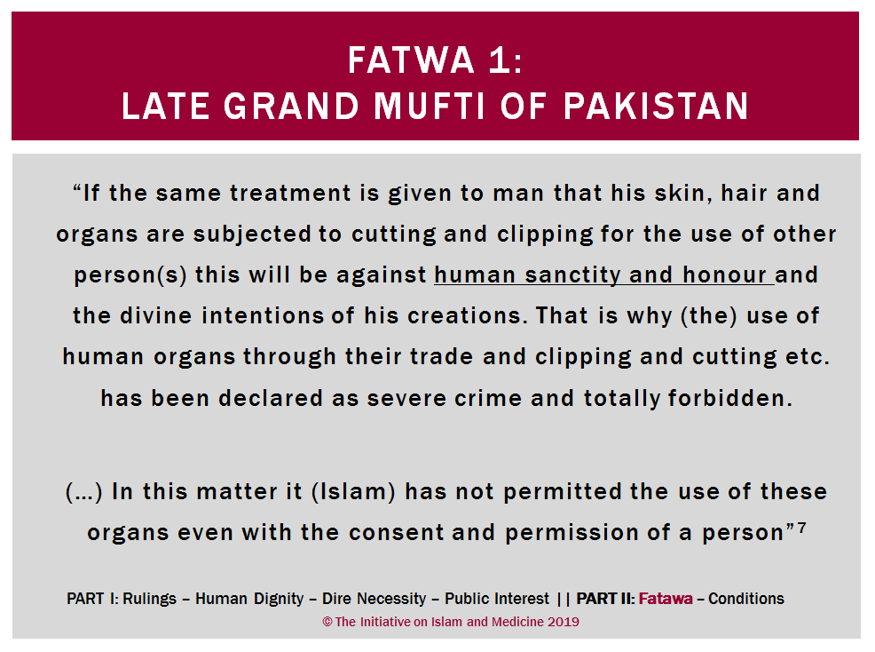

Slide 17
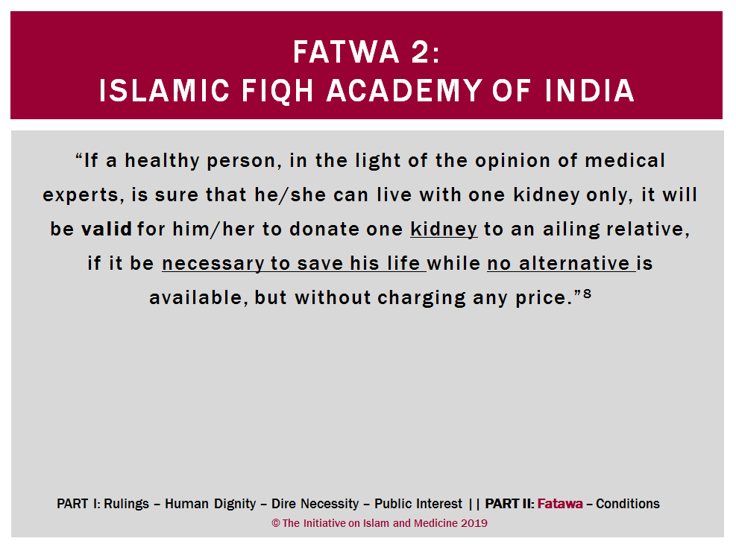

Slide 18
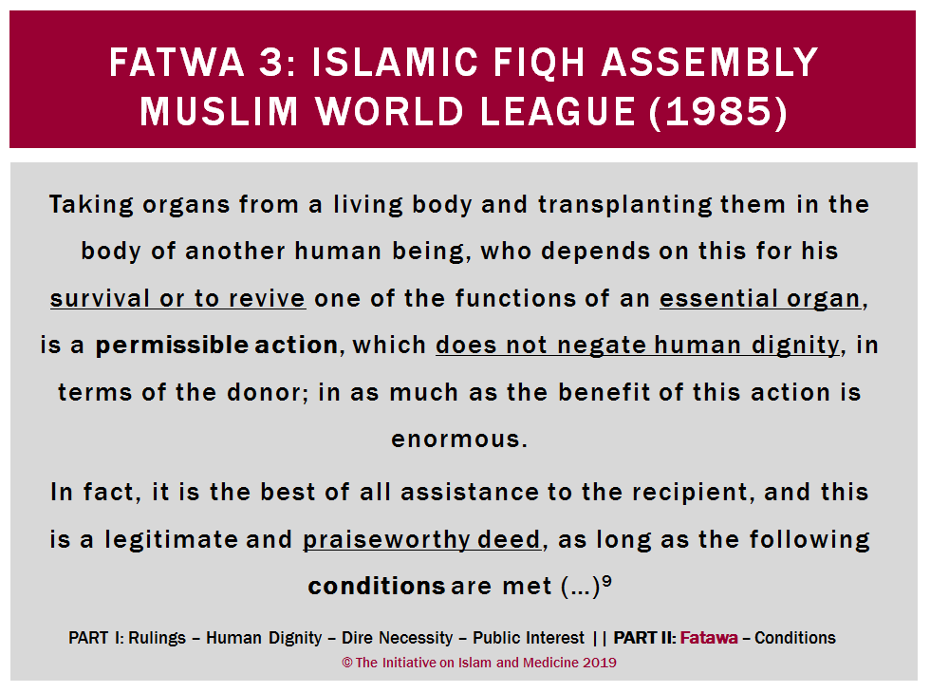
Notes:
http://www.amjaonline.org/fatwa-1881/info
“The council of the Assembly concluded that the view of those who approve of the permissibility of organ transplantating is the more acceptable, and therefore, the council has decided the following:
Taking organs from a living body and transplanting them in the body of another human being, who depends on this for his survival or to revive one of the functions of an essential organ, is a permissible action, which does not negate human dignity, in terms of the donor; inasmuch as the benefit of this action is anermous. In fact, it is the best of all assistance to the recipient, and this is a legitimate and praiseworthy deed, as long as the following conditions are met:
That taking the organ from the donor does not harm him in a way that disturbs his normal life, because the legal principle is: “Harm is not removed with similar harm, not with anything worde than it.” Because donation in that case would be like throwing one’s self into destruction (2:195), which is not legally permissible;
That the organ be given voluntarily by the donor without compulsion
That transplanting the organ be the only possible medical way to treat the patient;
That the success of each operation – removal and transplant – is achieved either usually or most of the time
First: It is permissible to remove an organ from one person’s body that is still alive and transplant it into another person’s body that needs this organ to save his life or restore an organ’s regular function. The permissibility here is conditioned by the following.
Such a act will not cause any harm or weakness to the donor or prevent him from living his life normally, as the Islamic rule states that “Harm can not be warded off by an equivalent or greater harm.” Furthermore, donation in such a situation would be equavalent to throwing oneself into certain destruction, which is impermissible from the Islamic viewpoint
The donor gives the organ willingly, with no compulsion
The transplantation of that organ is the only medical treatment for the patient
That the success of both removing the organ and transplanting it is certain or at least most likely

Slide 19
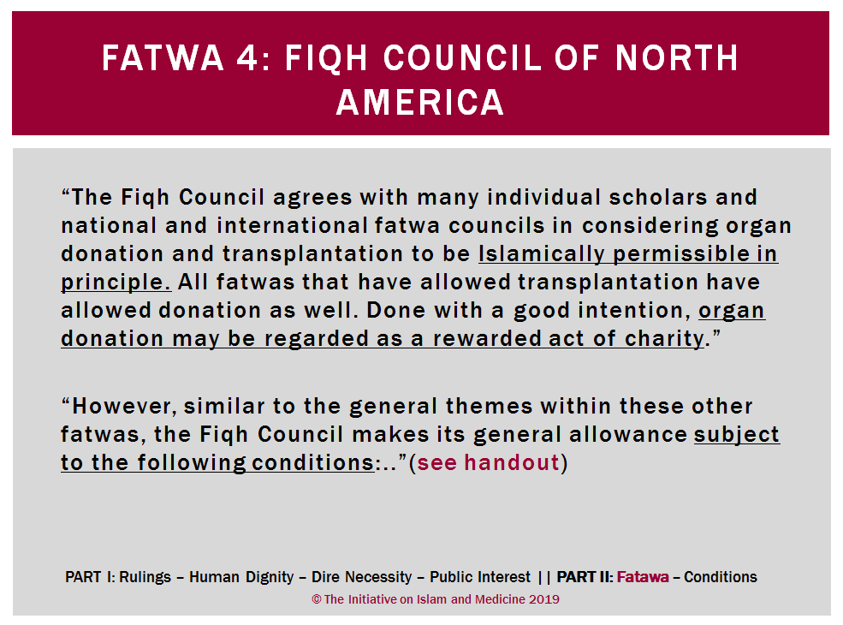
Notes:
http://www.amjaonline.org/fatwa-1881/info
“The council of the Assembly concluded that the view of those who approve of the permissibility of organ transplantating is the more acceptable, and therefore, the council has decided the following:
Taking organs from a living body and transplanting them in the body of another human being, who depends on this for his survival or to revive one of the functions of an essential organ, is a permissible action, which does not negate human dignity, in terms of the donor; inasmuch as the benefit of this action is anermous. In fact, it is the best of all assistance to the recipient, and this is a legitimate and praiseworthy deed, as long as the following conditions are met:
That taking the organ from the donor does not harm him in a way that disturbs his normal life, because the legal principle is: “Harm is not removed with similar harm, not with anything worde than it.” Because donation in that case would be like throwing one’s self into destruction (2:195), which is not legally permissible;
That the organ be given voluntarily by the donor without compulsion
That transplanting the organ be the only possible medical way to treat the patient;
That the success of each operation – removal and transplant – is achieved either usually or most of the time
First: It is permissible to remove an organ from one person’s body that is still alive and transplant it into another person’s body that needs this organ to save his life or restore an organ’s regular function. The permissibility here is conditioned by the following.
Such a act will not cause any harm or weakness to the donor or prevent him from living his life normally, as the Islamic rule states that “Harm can not be warded off by an equivalent or greater harm.” Furthermore, donation in such a situation would be equavalent to throwing oneself into certain destruction, which is impermissible from the Islamic viewpoint
The donor gives the organ willingly, with no compulsion
The transplantation of that organ is the only medical treatment for the patient
That the success of both removing the organ and transplanting it is certain or at least most likely

Slide 20
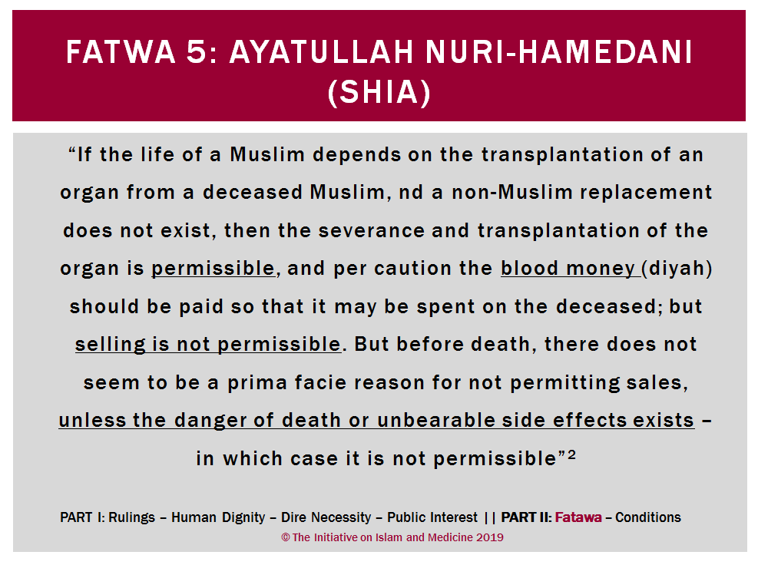
Notes:
http://www.amjaonline.org/fatwa-1881/info
“The council of the Assembly concluded that the view of those who approve of the permissibility of organ transplantating is the more acceptable, and therefore, the council has decided the following:
Taking organs from a living body and transplanting them in the body of another human being, who depends on this for his survival or to revive one of the functions of an essential organ, is a permissible action, which does not negate human dignity, in terms of the donor; inasmuch as the benefit of this action is anermous. In fact, it is the best of all assistance to the recipient, and this is a legitimate and praiseworthy deed, as long as the following conditions are met:
That taking the organ from the donor does not harm him in a way that disturbs his normal life, because the legal principle is: “Harm is not removed with similar harm, not with anything worde than it.” Because donation in that case would be like throwing one’s self into destruction (2:195), which is not legally permissible;
That the organ be given voluntarily by the donor without compulsion
That transplanting the organ be the only possible medical way to treat the patient;
That the success of each operation – removal and transplant – is achieved either usually or most of the time
First: It is permissible to remove an organ from one person’s body that is still alive and transplant it into another person’s body that needs this organ to save his life or restore an organ’s regular function. The permissibility here is conditioned by the following.
Such a act will not cause any harm or weakness to the donor or prevent him from living his life normally, as the Islamic rule states that “Harm can not be warded off by an equivalent or greater harm.” Furthermore, donation in such a situation would be equavalent to throwing oneself into certain destruction, which is impermissible from the Islamic viewpoint
The donor gives the organ willingly, with no compulsion
The transplantation of that organ is the only medical treatment for the patient
That the success of both removing the organ and transplanting it is certain or at least most likely

Slide 21
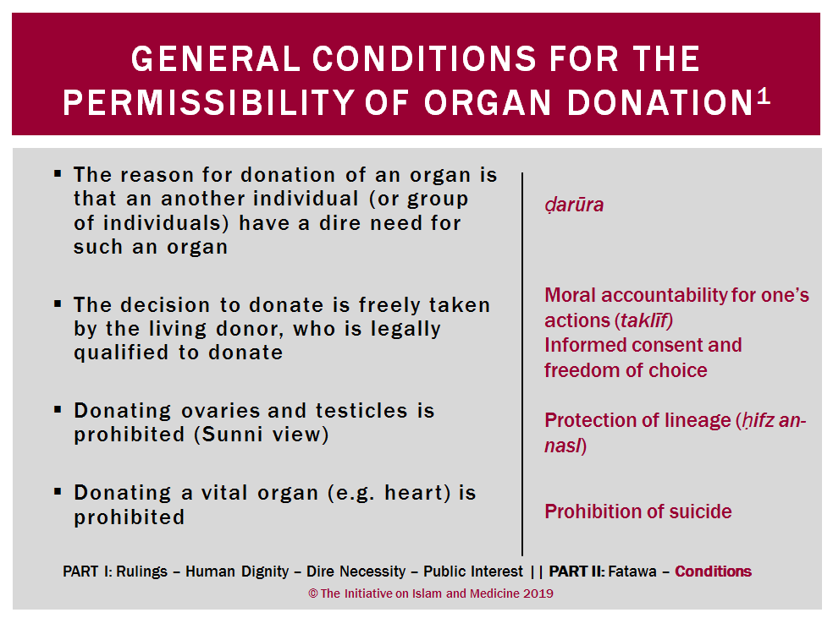

Slide 22
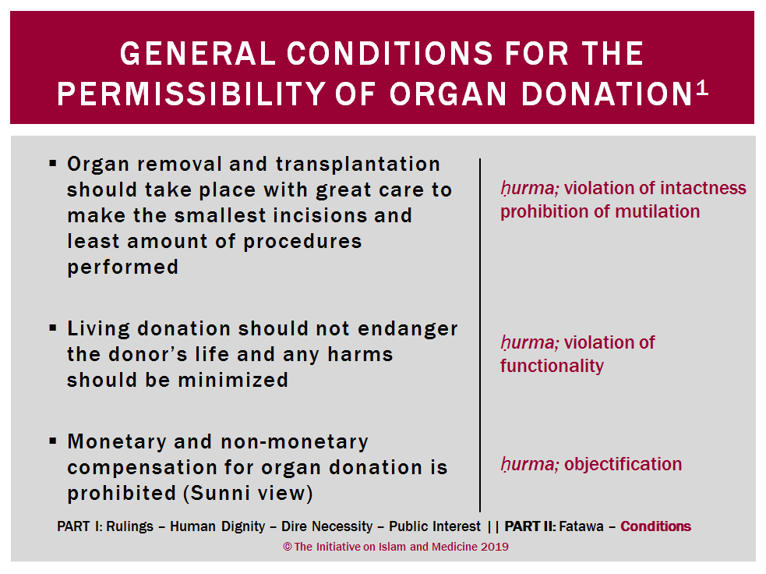

Slide 23
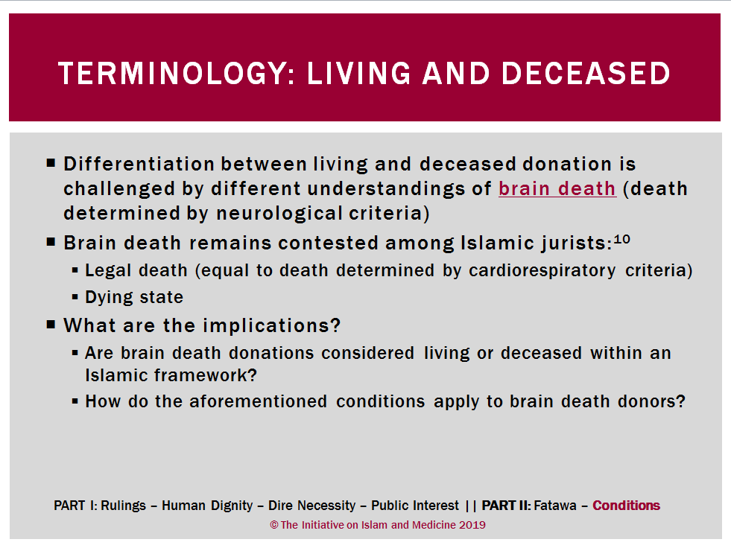

Slide 24
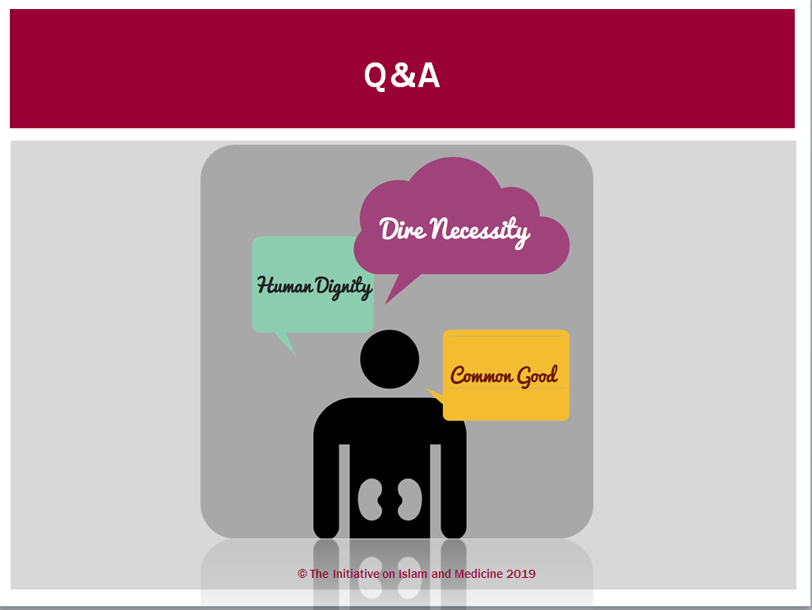
Notes:
Note: Use this slide as an opportunity to pause and engage audience in discussion.

Slide 25
